Slide 1
User Authentication
Passwords

Slide 2
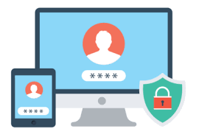
What is User Authentication?
What do you mean by User?
Well a user means a person/individual/client who uses something is known as user.
ex: user orders food, user uses social media, etc.
Authentication come from the word authentic which means genuine/real.
The process of proving something is true is called as Authentication.

Slide 3
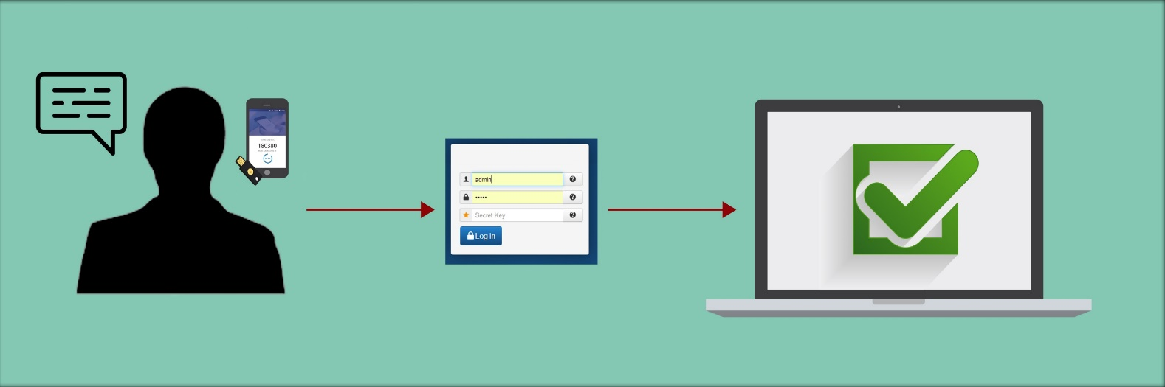
User Authentication Meaning.
User authentication means a process to prove whether the user is authentic or not.
How do we determine whether a user’s identity is authentic or not?

Slide 4
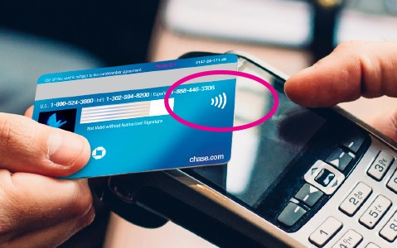
Types of user authentication.
Generally user authentication is based on one or more thing.
1) User owns a KEY(email + password) or CARD(RFID).
2) User’s knowledge of something( your school name,
your fav food).
3) User’s attribute ( fingerprint, retina, signature)

Slide 5
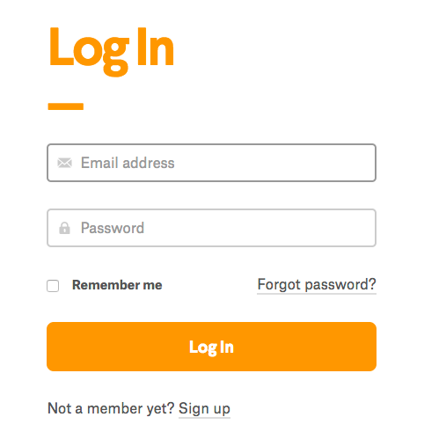
What is password?
Password means: a secret word that must be used to gain admission to a place.
It is the most common approach to authenticate a user is to use a password.
Whenever the user identify itself by providing email or username,
he/she has to entered a password for authentication.

Slide 6
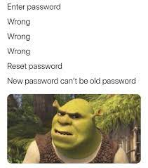
Login or Signup?
If the user entered correct password and it matches with the password which is stored in the system, the system consider the account is accessed by owner(authentic).
Otherwise:

Slide 7
Can someone crack your password?
There are mainly 2 ways by which you can crack someone's password.
1) Personally
2) Brute Force
Hackers use "brute force” algorithms that generate thousands of password guesses per second. The longer the password, the more computing power
it takes to generate the right guess.

Slide 8
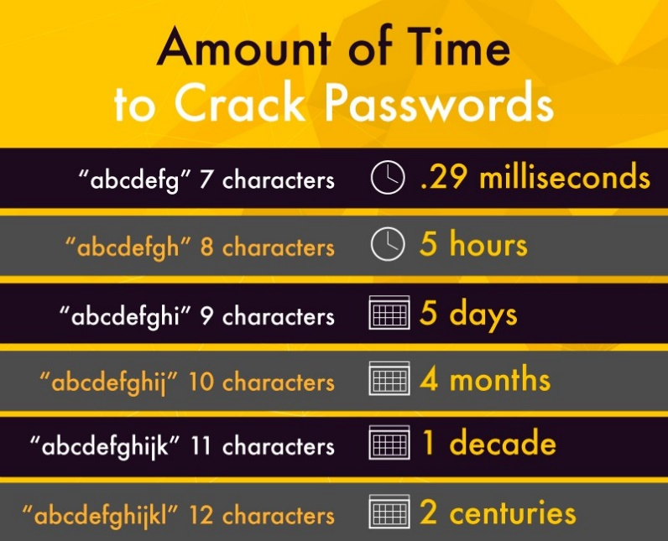
How safe is your password?
Check, how secure your password is.!
https://www.security.org/how-secure-is-my-password/

Slide 9
So, that’s all for today we will meet in the next viva.
Thank you.

